Slide 1
Project Magma Prototype
Dominik Käser
Christian Oberholzer
Janick Bernet

Slide 2
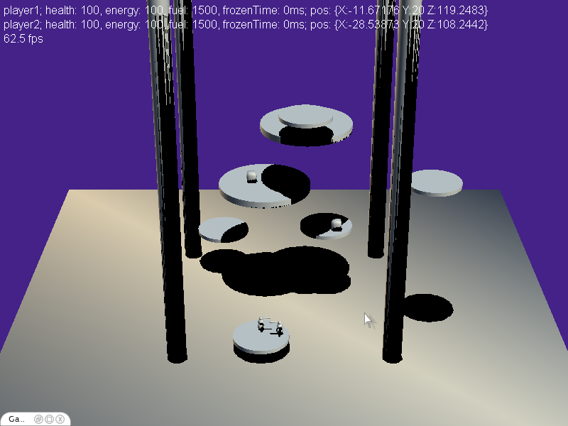
Prototype Elements
Lava
Pillars
Moving Islands
Powerups
Shadows
Console

Slide 3
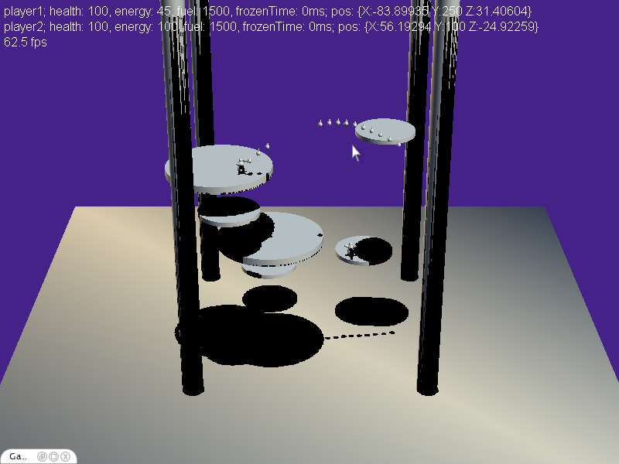
Prototype Interactions
Ice spike
Jetpack
Hit & pushback
Sound

Slide 4
Prototype Insights
Positioning
Add shadows
Player contours
Camera (angle, focal length)
Intra-Island movement
Don’t fall from island
Inter-Island movement
More passive approach (island selection)
Other means of movement (beaming, hook)
Parameter tuning

